Slide 1


JUnit Testing
SDET Fundamental Training

Slide 2

History
Kent Beck developed the first xUnit automated test tool for Smalltalk in mid-90’s
Beck and Gamma (of design patterns Gang of Four) developed JUnit on a flight from Zurich to Washington, D.C.
Martin Fowler: “Never in the field of software development was so much owed by so many to so few lines of code.”
Junit has become the standard tool for Test-Driven Development in Java
Junit test generators now part of many Java IDEs (Eclipse, BlueJ, Jbuilder, DrJava)
Xunit tools have since been developed for many other languages (Perl, C++, Python, Visual Basic, C#, …)

Slide 3
History
Obviously you have to test your code—right?
You can do ad hoc testing (running whatever tests occur to you at the moment), or
You can build a test suite (a thorough set of tests that can be run at any time)
Disadvantages of a test suite
It’s a lot of extra programming
True, but use of a good test framework can help quite a bit
You don’t have time to do all that extra work
False! Experiments repeatedly show that test suites reduce debugging time more than the amount spent building the test suite
Advantages of a test suite
Reduces total number of bugs in delivered code
Makes code much more maintainable and refactorable

Slide 4
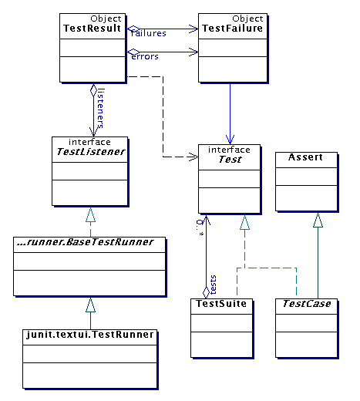
Architectural Overview
JUnit test framework is a package of classes that lets you write tests for each method, then easily run those tests
TestRunner runs tests and reports TestResults
You test your class by extending abstract class TestCase
To write test cases, you need to know and understand the Assert class

Slide 5
Writing a TestCase
To start using JUnit, create a subclass of TestCase, to which you add test methods
Here’s a skeletal test class:
import junit.framework.TestCase;
public class Mortgage extends TestCase {
//Test my class Bowl
}

Slide 6
Writing Methods in TestCase
Pattern follows programming by contract paradigm:
Set up preconditions
Exercise functionality being tested
Check postconditions
public void testMortgageSanction() {
Mortgage m = new Mortagage();
assertEquals(“Number of Loans Sanctioned today ”,
0,m.checkNumberOfSanction());
assertTrue(“An empty bowl should report empty.”, emptyBowl.isEmpty());
}

Slide 7

Assert Methods
Each assert method has parameters like these: message, expected-value, actual-value
Assert methods dealing with floating point numbers get an additional argument, a tolerance
Each assert method has an equivalent version that does not take a message – however, this use is not recommended because:
messages helps documents the tests messages provide additional information when reading failure logs

Slide 8
Assert Methods
assertTrue(String message, Boolean test)
assertFalse(String message, Boolean test)
assertNull(String message, Object object)
assertNotNull(String message, Object object)
assertEquals(String message, Object expected, Object actual) (uses equals method)
assertSame(String message, Object expected, Object actual) (uses == operator)
assertNotSame(String message, Object expected, Object actual)

Slide 9
Annotations
@Before
@BeforeClass
@Test
@After
@AfterClass

Slide 10
TestSuites
package com.naveen.junit;
import org.junit.runner.RunWith;
import org.junit.runners.Suite;
@RunWith(Suite.class)
@Suite.SuiteClasses({
TestMorgage.class
})
public class SuiteTestExample {
}

Slide 11

http://www.junit.org Download Junit Documentation and Information

